Slide 1
RESEARCH AGENT
CAPSTONE PROJECT
Presented By:
1. Chandramugi P S – V S B College of Engineering Technical Campus – Dept: Artificial Intelligence &Data Science

Slide 2
OUTLINE
Problem Statement
Proposed System/Solution
System Development Approach
Algorithm & Deployment
Result
Conclusion
Future Scope
References

Slide 3
Problem Statement
A Research Agent is an AI system designed to assist with academic and scientific research tasks. It can autonomously search for literature, summarize papers, and organize references. Using natural language processing, it understands research questions and retrieves relevant information. The agent can generate reports, suggest hypotheses, and even draft sections of research papers. It saves time by automating repetitive tasks like citation management and data extraction. Research Agents enhance efficiency, accuracy, and innovation in both academic and industrial R&D.

Slide 4
Proposed Solution
The proposed solution is an intelligent, cloud-based AI Research Assistant designed to help academic users automate repetitive research tasks like summarization, keyword extraction, and citation generation. This system utilizes IBM Watsonx's Granite Foundation Model through prompt engineering, requiring no custom model training or dataset preparation.
The solution is structured into the following key components:
🔹 1. Prompt-Based Interaction
Instead of building or training a model from scratch, the system uses prompt engineering to guide IBM’s Granite LLM (Granite-13b-chat) for specific tasks such as:
Summarizing large academic texts , Extracting relevant keywords or entities
Generating formatted citations (APA, BibTeX), Answering research-related questions from input data
🔹 2. Watsonx Prompt Lab
The prompt development and testing were performed using IBM's Prompt Lab, a visual environment in Watsonx.ai, which allows developers to interactively test prompts with different foundation models. The best-performing prompts were saved as notebooks for documentation and reproducibility.
🔹 3. Notebook Deployment
Once prompts were finalized and responses were verified, the project was exported as a Jupyter Notebook, ensuring that:
Prompt structure is documented, Input-output is traceable
Can be shared via GitHub or IBM Cloud
🔹 4. Cloud-Based & Cost-Free
The project was built entirely using IBM Cloud Lite tier, making it cost-efficient and accessible for student developers. It used:
Watsonx.ai → for LLM access
Granite Model → for natural language processing
Watson Studio Notebook → for running code and exporting sessions, GitHub → for version control and sharing
🔹 5. No-Code Deployment (Optional)
Since the agent runs on prompts and saved notebooks, it requires no backend code to deploy. However, it can be extended in future using APIs or chatbot frameworks.

Slide 5
System Approach
SYSTEM REQUIREMENTS:
Platform: IBM Watsonx.ai (Cloud-based – no local installation required)
Cloud Plan: IBM Cloud Lite (Free tier)
User Interface: Watsonx Prompt Lab and Jupyter Notebook
Storage: Cloud Object Storage (auto-attached to Watsonx project)
Access: Web browser (Chrome/Edge/Firefox), IBM Cloud account
LIBRARIES USED: Since it's a prompt-based system (not code-heavy), minimal libraries were needed.
LLM Access – Granite-13b-instruct-v2 model
Notebook Interface – Jupyter Notebokk (Watsonx Studio)
Optional Python Packages – ibm.watsonx-ai , requests , json
GitHub Integration – Web based Git CLI or Github Desktop

Slide 6
Algorithm & Deployment
Algorithm Selection:
This project uses Granite-13b-instruct-v2, an instruction-tuned Large Language Model (LLM) provided by IBM on the Watsonx.ai platform.
Pre-trained by IBM on diverse academic and domain-specific corpora
Instruction-tuned: Responds better to specific research-related tasks , No custom training required
Ideal for natural language tasks like:
Summarizing complex academic papers , Extracting technical keywords
Generating proper citations, Assisting with hypothesis framing
Data Input:
Model accepts:
Research paper content (abstracts, full text) , Task-specific instructions , Prompt structure crafted in Prompt Lab
Eg: "Summarize the following research article in 3 bullet points: [Article]"
Training Process:
. Model is already pre-trained and instruction-tuned.
Prediction Process:
Granite-13b-instruict-v2 processes the input using its instruction-tuned LLM
Responds with natural language output :
Summary
Keywords
APA or BibTex Citations
Research Recommendations
Output is viewed in Prompt Lab or exported as Notebook
No code needed- the model functions via API or Prompt Lab GUI

Slide 7
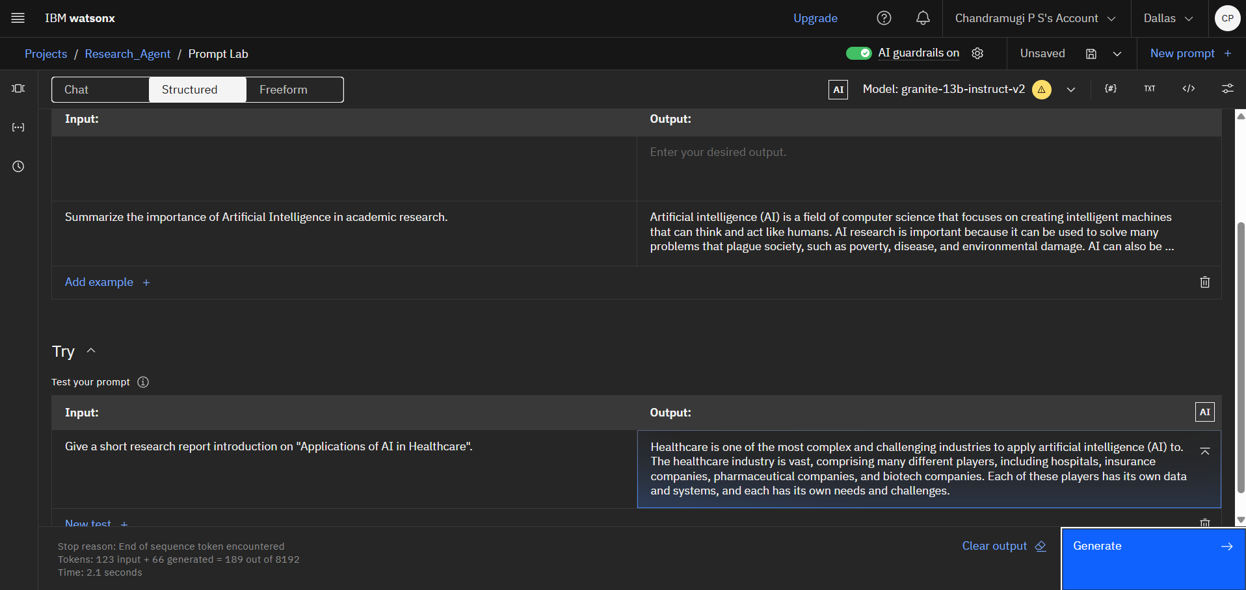
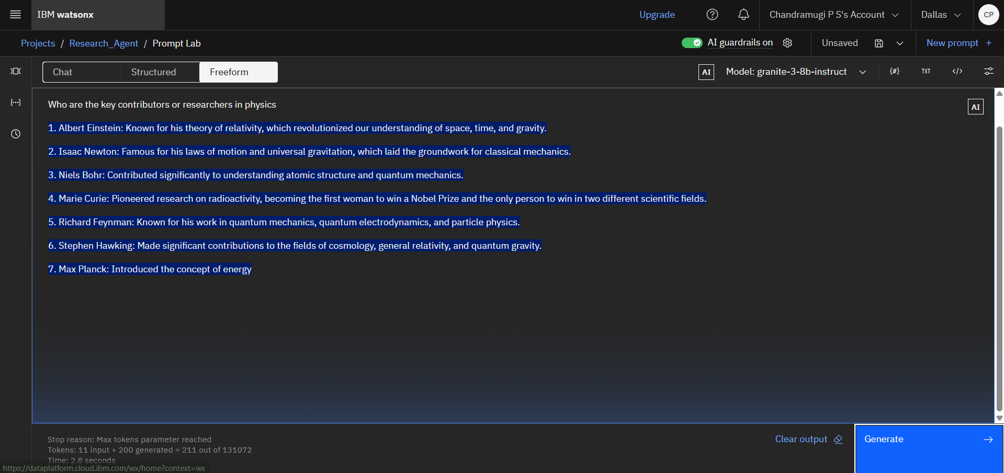
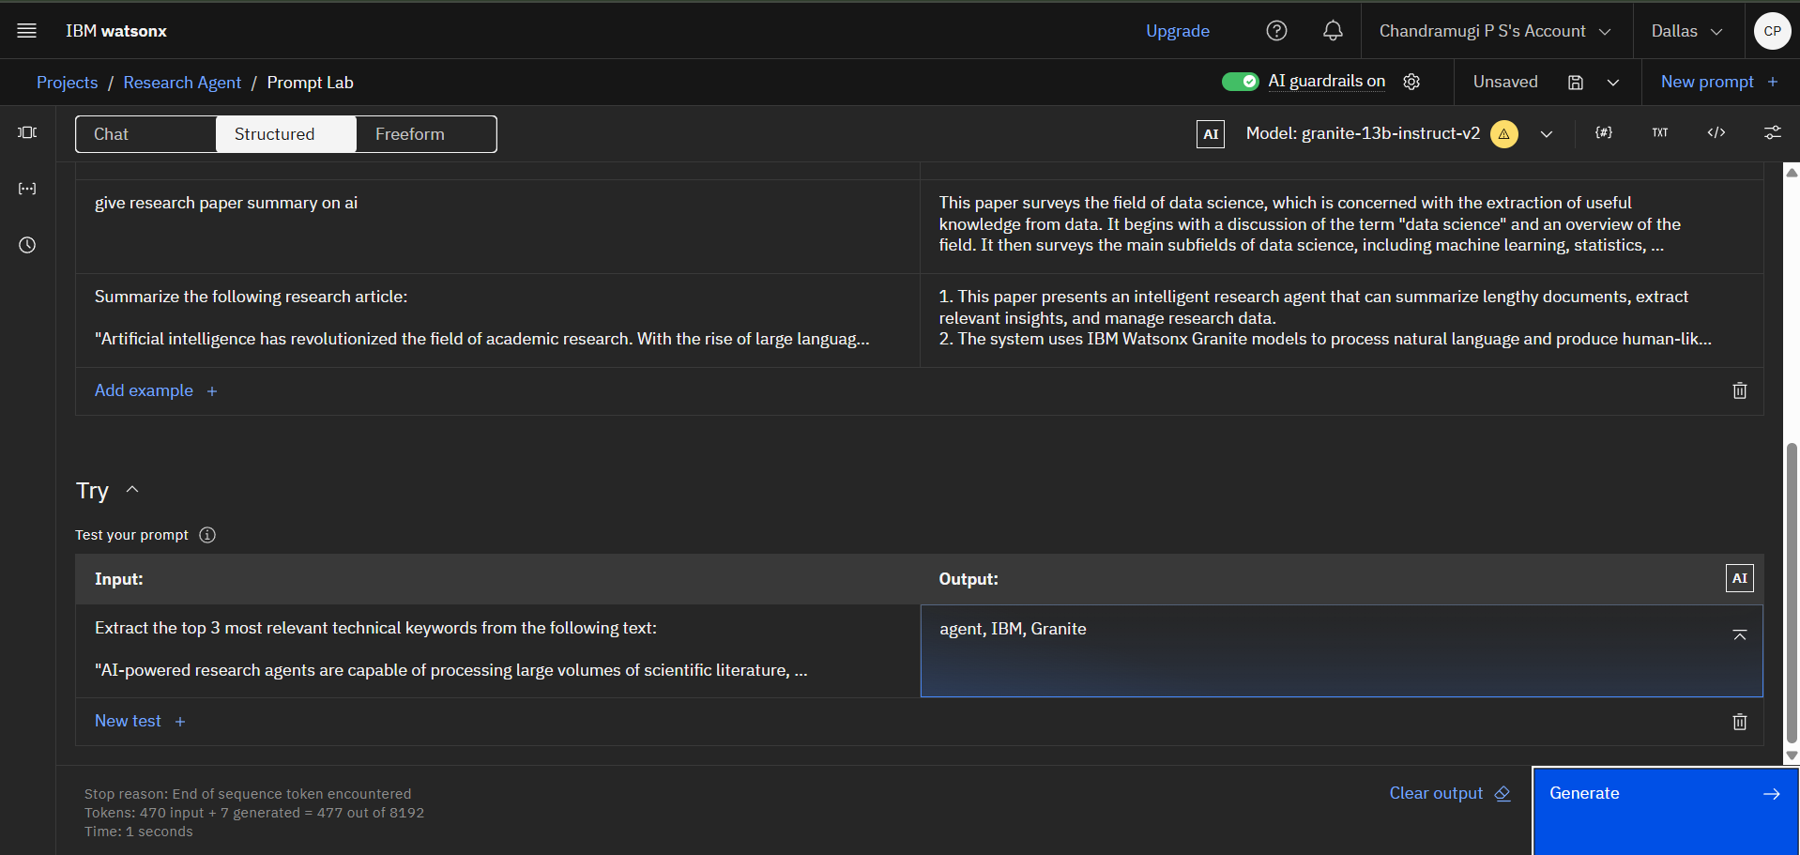
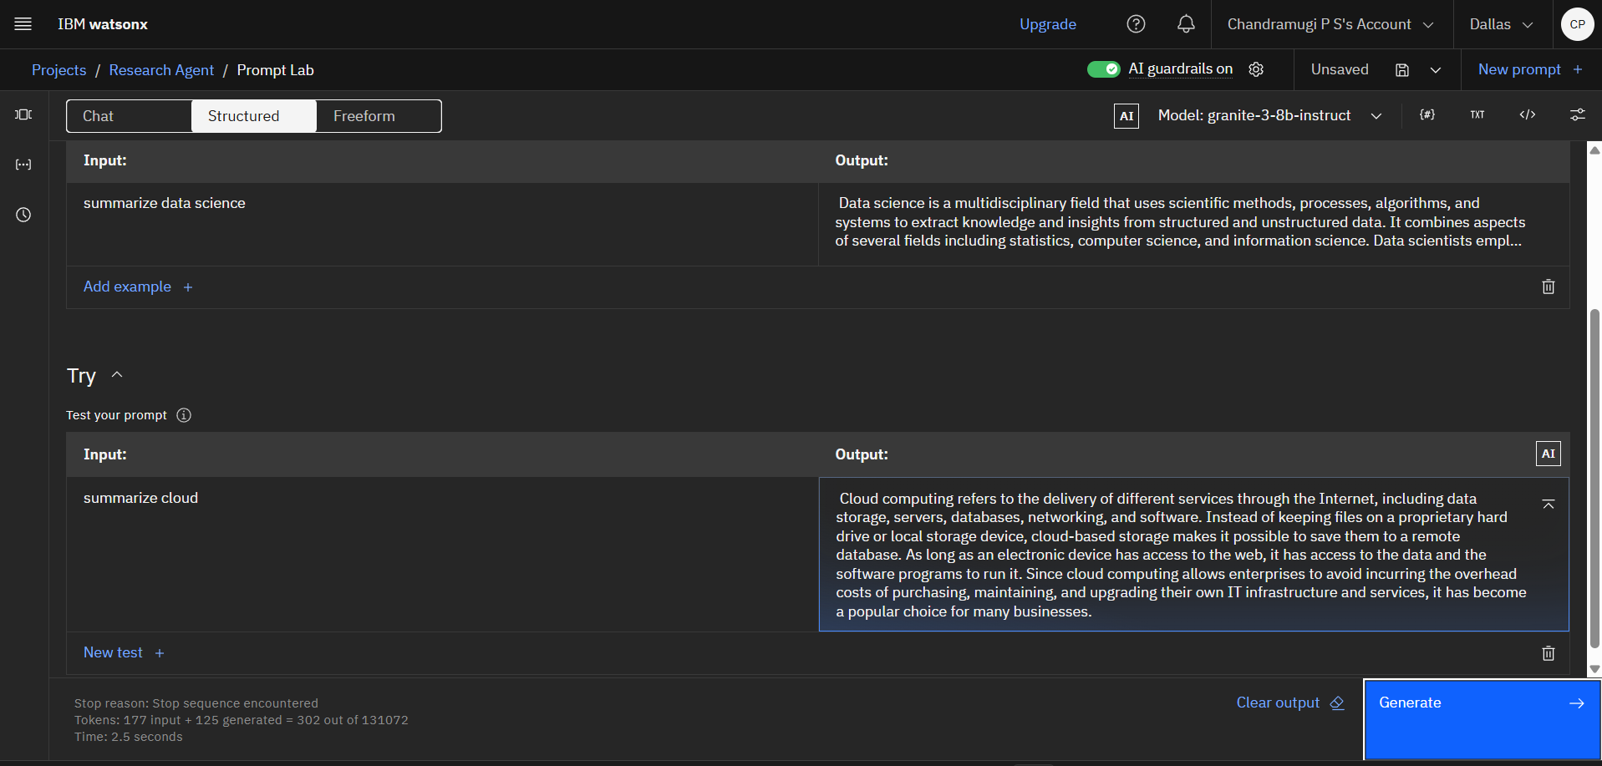
Result
.

Slide 8
Conclusion
The proposed AI-powered Research Agent effectively demonstrates the capabilities of IBM Watsonx’s Granite-13b-instruct-v2 foundation model in solving real-world academic research tasks.
Using prompt engineering, the system was able to:
Summarize long academic texts
Extract keywords
Generate proper citations
Respond contextually to research queries
The project successfully avoided the complexity of model training by using IBM’s instruction-tuned LLM, making it efficient and accessible for student and academic use.
Challenges Faced
Finding the right prompt structure to get high-quality outputs took experimentation.
Initially faced minor confusion about using Granite via Prompt Lab vs SDK.
Watson Studio notebooks had limited access to newer SDK features.

Slide 9
Future scope
PDF Auto-Processing – Automate reading & summarizing uploaded papers
Chatbot Integration – Convert into an interactive research assistant
Citation Tool Support – Link with Zotero or Mendeley
Granite API Usage – Automate prompts via code (no manual steps)
Multilingual Support – Translate & analyze papers in other languages
RAG Integration – Use vector-based document retrieval for grounded answers
Web App / Plugin – Deploy as a research assistant tool for students & teams

Slide 10
References
IBM Watsonx.ai Documentation - https://www.ibm.com/cloud/watsonx-ai
IBM Granite Foundation Models Overview - https://www.ibm.com/blog/ibm-watsonx-granite-models/
Prompt Engineering Guide – IBM Prompt Lab - https://www.ibm.com/docs/en/watsonx
GitHub Repository – Project Source Code - https://github.com/ChandramugiPS/IBM---Research-agent-
Edunet Foundation – IBM SkillBuild Internship Curriculum
Article: “Prompt Engineering Techniques for LLMs” Source: Medium.com / Towards Data Science
Documentation: ibm-watsonx-ai Python SDK https://pypi.org/project/ibm-watsonx-ai/

Slide 11
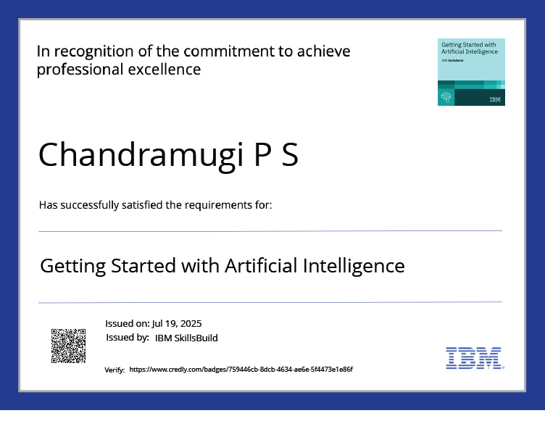
IBM Certifications

Slide 12
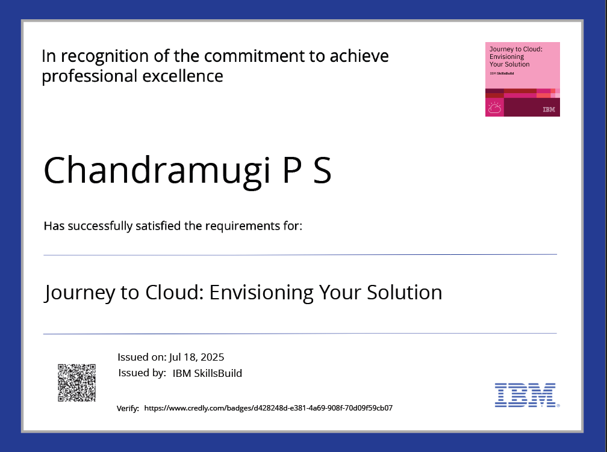
IBM Certifications

Slide 13
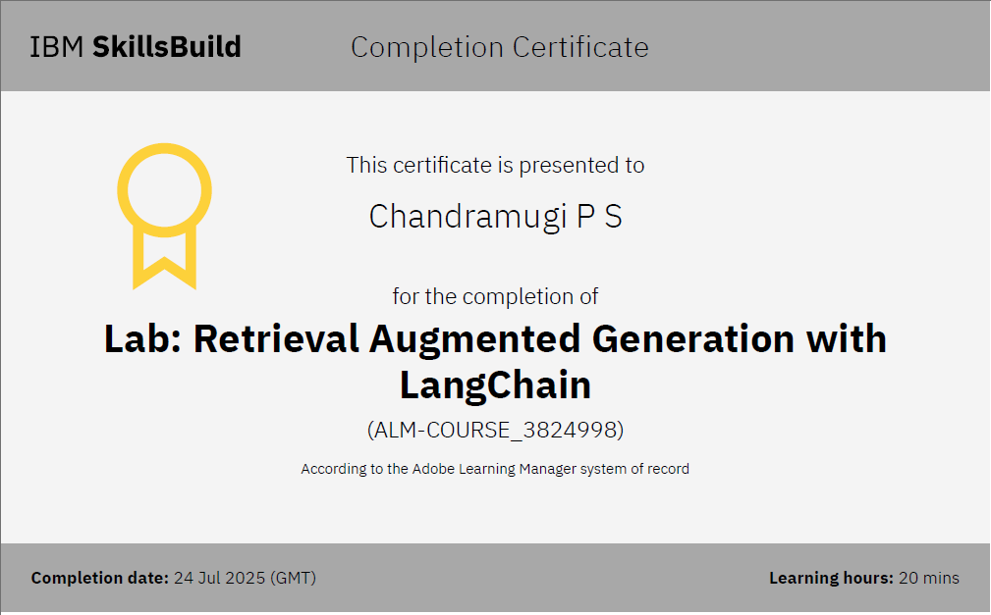
IBM Certifications

Slide 14
THANK YOU

